Slide 1
ABX Store Sales Analysis

Slide 2
Problem Statement
ABX Store want to increase their sales in United States by 20%.
They need information on where to run ad campaigns and which customers to target with their ads
They require thorough information so they can prepare a good strategy to increase their sales.
ABX Store Sales Analysis

Slide 3
Data Exploration & Cleaning.
Explore Entity Relationship Diagram.
Explore & understanding the data before analysis.
If any issues or error found in data, clean it before analysis.
ABX Store Sales Analysis

Slide 4
Data Analysis Process.
List Top 3 products by revenue.
Show Top 3 months of the year by revenue.
Show Top 3 states where Top 3 products are purchased in high quantity.
Show which group people generated most revenue in Top 3 states.
ABX Store Sales Analysis

Slide 5
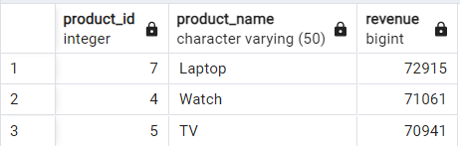
Top 3 products by Revenue.
The Top 3 products that generated most amount of revenue for the ABX store are
ABX Store Sales Analysis

Slide 6
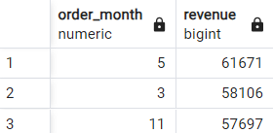
Top 3 Months by Revenue.
May
March
November
ABX Store Sales Analysis

Slide 7
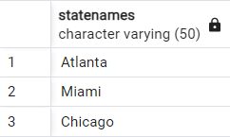
Top 3 States by Items Purchased.
Atlanta
Miami
Chicago
ABX Store Sales Analysis

Slide 8

Top Age group by Revenue Generated.
ABX Store Sales Analysis

Slide 9
Insights
ABX Store need to focus on Laptop, Watches and Tv’s as they generated more revenue and in high demand.
ABX Store need to target customers in Atlanta, Miami and Chicago and can run ad campaigns for top 3 products in this states.
The sales are high in March, May and November so, ABX store need to run more ad campaigns in this months.
People ageing between 31-50 generated more revenue so, this age group should be targeted through ad campaigns.
ABX Store Sales Analysis

Slide 10
Thank you
Suyog Yadav​
yadavsuyog623@gmail.com
GitHub

